Slide 1
ISO & GeoDCAT-AP metadata implementation pilot
European Commission SEMIC Group (DG DIGIT), DG JRC, Publications Office of the European Union
& Member States
Antonio Rotundo (Italy)
Phase2 Kick-off Meeting
December 5, 2025

Slide 2
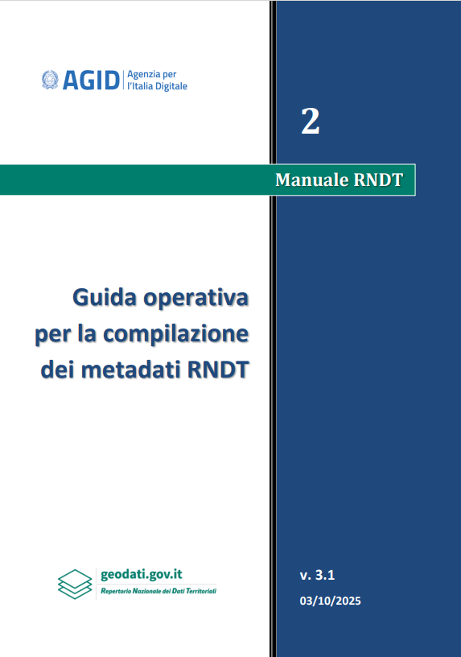
Pilot report
Italy
News at national level
  National metadata profile updated by including the rules for tagging HVDs as agreed in the Phase 1
  Validation system and national XSLT updated as well
  Assessment activities ongoing for the migration of the national OD portal to DCAT-AP v3 (which will be followed by migration to GeoDCAT-AP v3)
Phase 1 – Feedback
  We need to implement the activities identified and fix the issues raised in the Phase 1. Inter alia:
    Common repository to share transformation assets between Member States;
    Coordination and documentation
    Addressing the issues related to Data Services and API endpoints
    Assessing the possible revision of the current INSPIRE metadata technical guidelines
IT metadata profile
for spatial data

Slide 3
Pilot report
Italy
Phase 2 – Expectations
  Reaching a common agreement on open issues in order to complete the definition and implementation of GeoDCAT-AP

